Slide 1



Unusual ways of getting around
Svetlichnaya Alina

Slide 2
—Life
“Everyone has his own way”

Slide 3
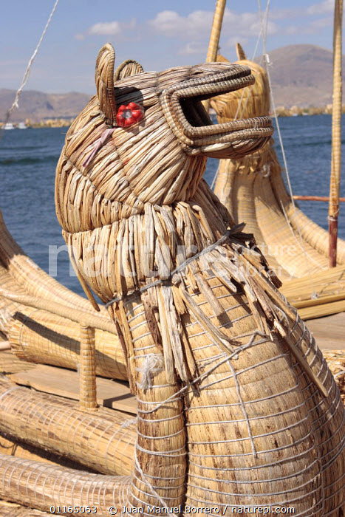
Totora reed boats

Slide 4
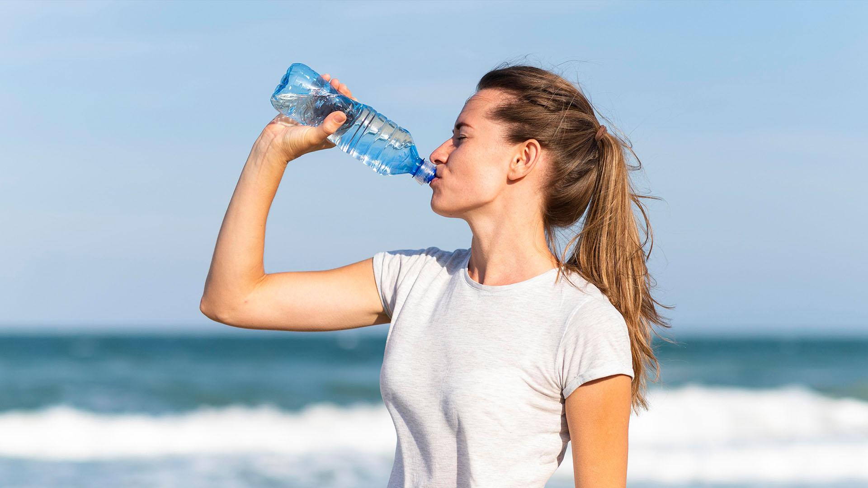
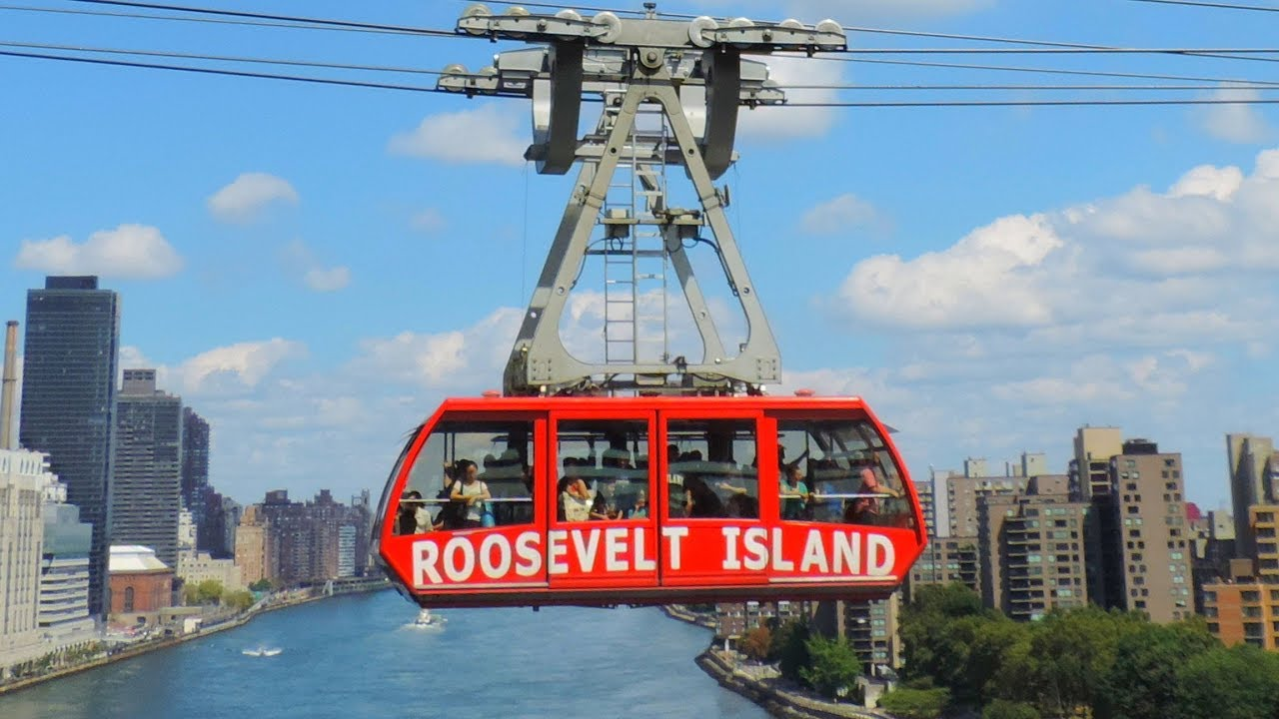



Slide 5
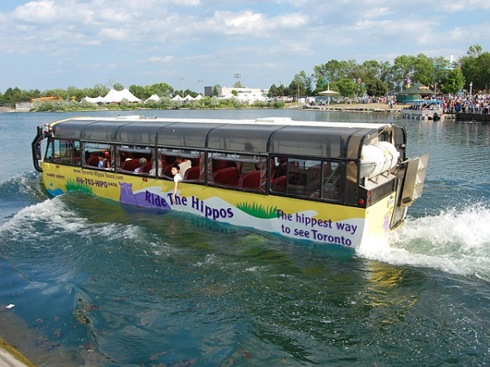
Swimming bus

Slide 6
Thank you

